Slide 1
Breast Cancer Detection using
Machine Learning Methods
Group 15: Sarah Baalbaki, William Hsu, Ethan Gaskin, Madison Stulir

Slide 2
Table of Contents
01
02
03
Introduction
Dataset
Methods
04
05
Results
Conclusion

Slide 3
01- Introduction
Breast cancer most common cancer in females in US, besides skin cancer (Ref 1-2)
Fine Needle Aspiration (FNA) Biopsy: common breast cancer diagnostic testing procedure (Ref 3)
Pros: Cheap, Minimally invasive
Cons: Interpretation, Sample size
Machine Learning methods may help overcome both cons
Algorithms may more consistently detect subtle instances of features correlated with cancer
Notes:
Breast cancer is one of the most common cancers in women in the United States
Cancer pathologists commonly use Fine Needle Aspiration Biopsy to investigate suspicious masses in patient breasts. The procedure is a preferred screening method for identifying cancer due to its minimal invasiveness and cost
However, misdiagnoses can happen due to the small sample size or image resolution
Our goal is to use machine learning to accurately capture the relationship between FNA sample images and cancer to improve diagnostic accuracy in early tests
The models we will use to accomplish this are based on the following dataset (NEXT SLIDE)
Archive:
It is about 30% of all new female cancers each year.
Mortality rates decreasing with time, but machine learning could accelerate breast cancer therapies
However due to the small sample size of cells it collects, sometimes misdiagnoses can happen, either from misinterpreting the images or not puncturing the mass properly.
Our goal is to use machine learning to help pathologists interpret fine needle aspirate results to help improve diagnostic accuracy in early tests. Ideally we hoped to use models which can accurately represent the relationship between fine needle aspirates and cancer diagnosis.

Slide 4
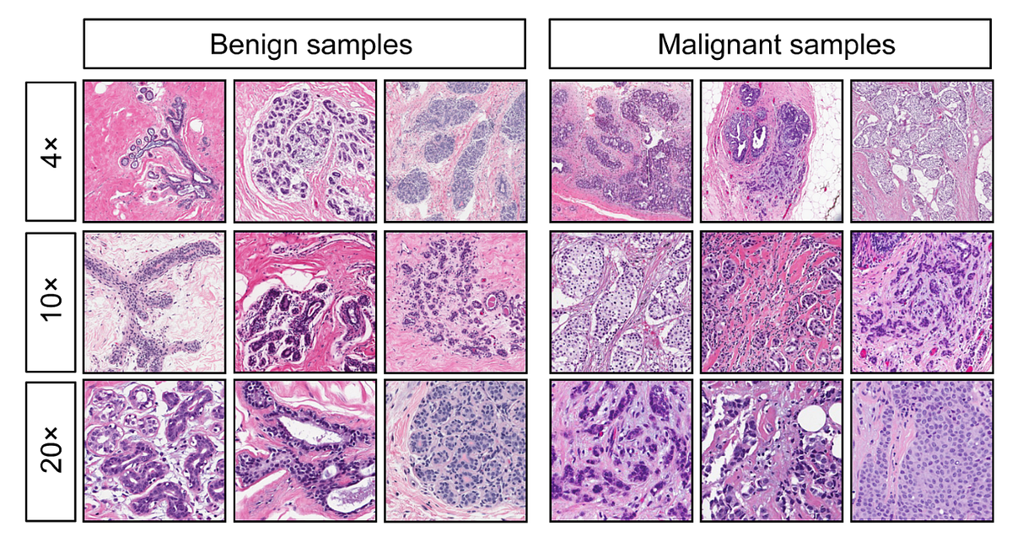
02- Dataset
Diagnostic Wisconsin Breast Cancer Database [Ref 4]
Labeled dataset classifying cancerous and non-cancerous cell nuclei based on the analysis of digitized images
Composed of ten different features/attributes of the nuclei
This dataset will be used to train three different supervised machine learning models to classify breast cancer tumors as malignant or benign.
Notes:
Our dataset comes from digitized FNA samples which includes key geometric information regarding the cell nuclei in the sample images.
We got the dataset from Kaggle, which sourced it from the Diagnostic Wisconsin Breast Cancer Database. There are 569 samples.
The dataset was complete, relatively small to medium in size, and had no extreme outliers, therefore we did little preprocessing
There are 10 real-valued, averaged, geometric features computed from the cell nuclei during the digitization of the aspirates. These included things such as nuclei radii, texture, perimeter, etc.
To explore the independence of the features and any correlations between features and diagnoses, we created a pairwise plot to inform model selection (NEXT SLIDE)
Archive:
https://machinelearningmastery.com/what-is-imbalanced-classification/
It is slightly imbalanced with 63% benign samples and 37% malignant samples
For each sample, each of the 10 features were computed for all cells present in an image then the mean used for that feature.
So how do we encode the fine needle aspirates in an interpretable manner for a computer and pathologists? One way to do this is to use image-processing methods to extract quantitative information which pathologists use for their diagnoses. This allows two things: One: samples to be interpreted by a computer and Two: natural interpretability of model results by oncologists

Slide 5
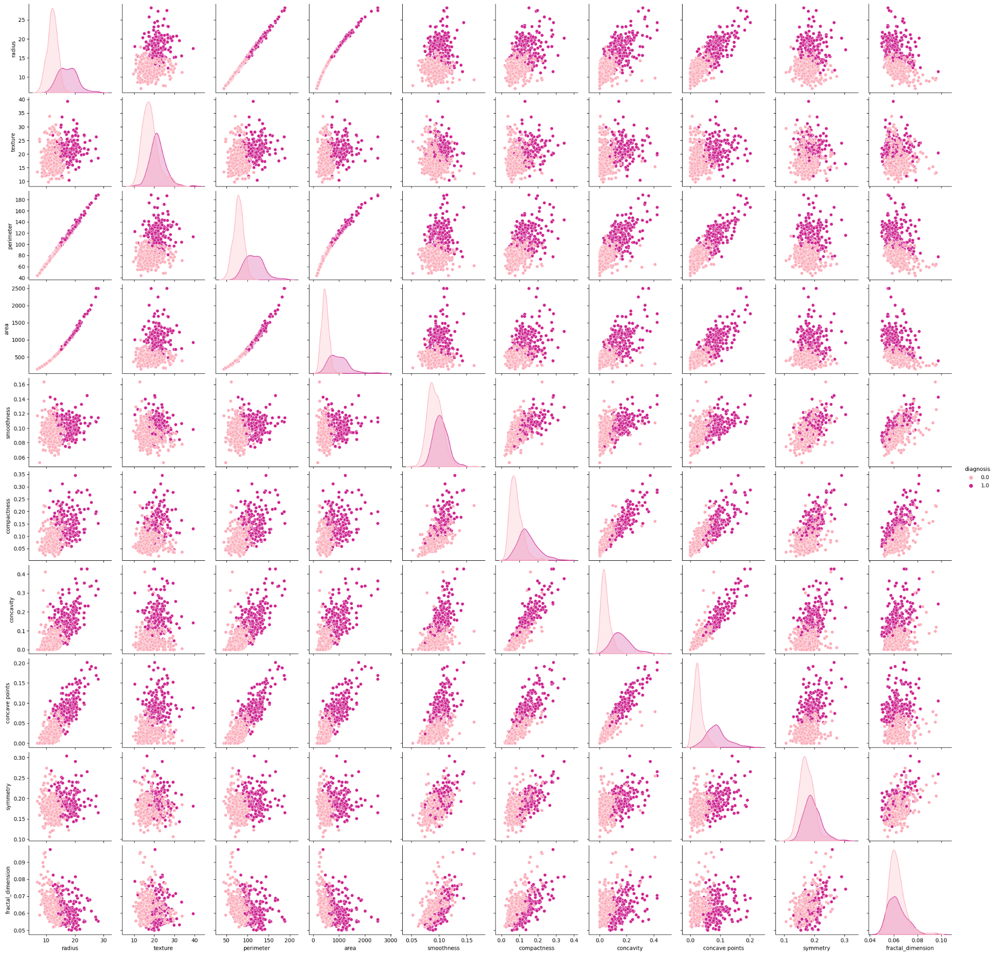
Pairwise plot of features labeled by diagnosis
Diagnosis
Benign
Malignant
Notes:
The plot reveals that the samples are approximately normally distributed in each feature under both classes and that almost every pair of features offered useful information in distinguishing the classes
This plots reveal linear separability of the classes in the pairwise distributions, which suggests they could be linearly separable in the complete feature space
ARCHIVE:
https://pythonbasics.org/seaborn-pairplot/
https://www.educative.io/answers/what-is-seabornpairplot
For our exploratory analysis of the data, we created a pairwise plot of the features labeled by diagnosis, shown here
The plot reveals that the samples are approximately normally distributed in each feature under both classes, which is shown along the main diagonal
The pair plots, which are off the main diagonal, show bivariate distribution of each feature and labels the samples. Ideally, we want to see that for each pair of features that there isn’t too much overlap between the two classes so that we know that the features contribute useful information in distinguishing the classes in a novel way which is independent of other features. That’s mostly what we see here.
Also, this allows us to explore the linear separability of the classes as well. If the classes generally appear linearly separable here, then they are likely separable in the complete feature space, 10 dimensions. This is true, and is confirmed later by our different SVM implementations

Slide 6
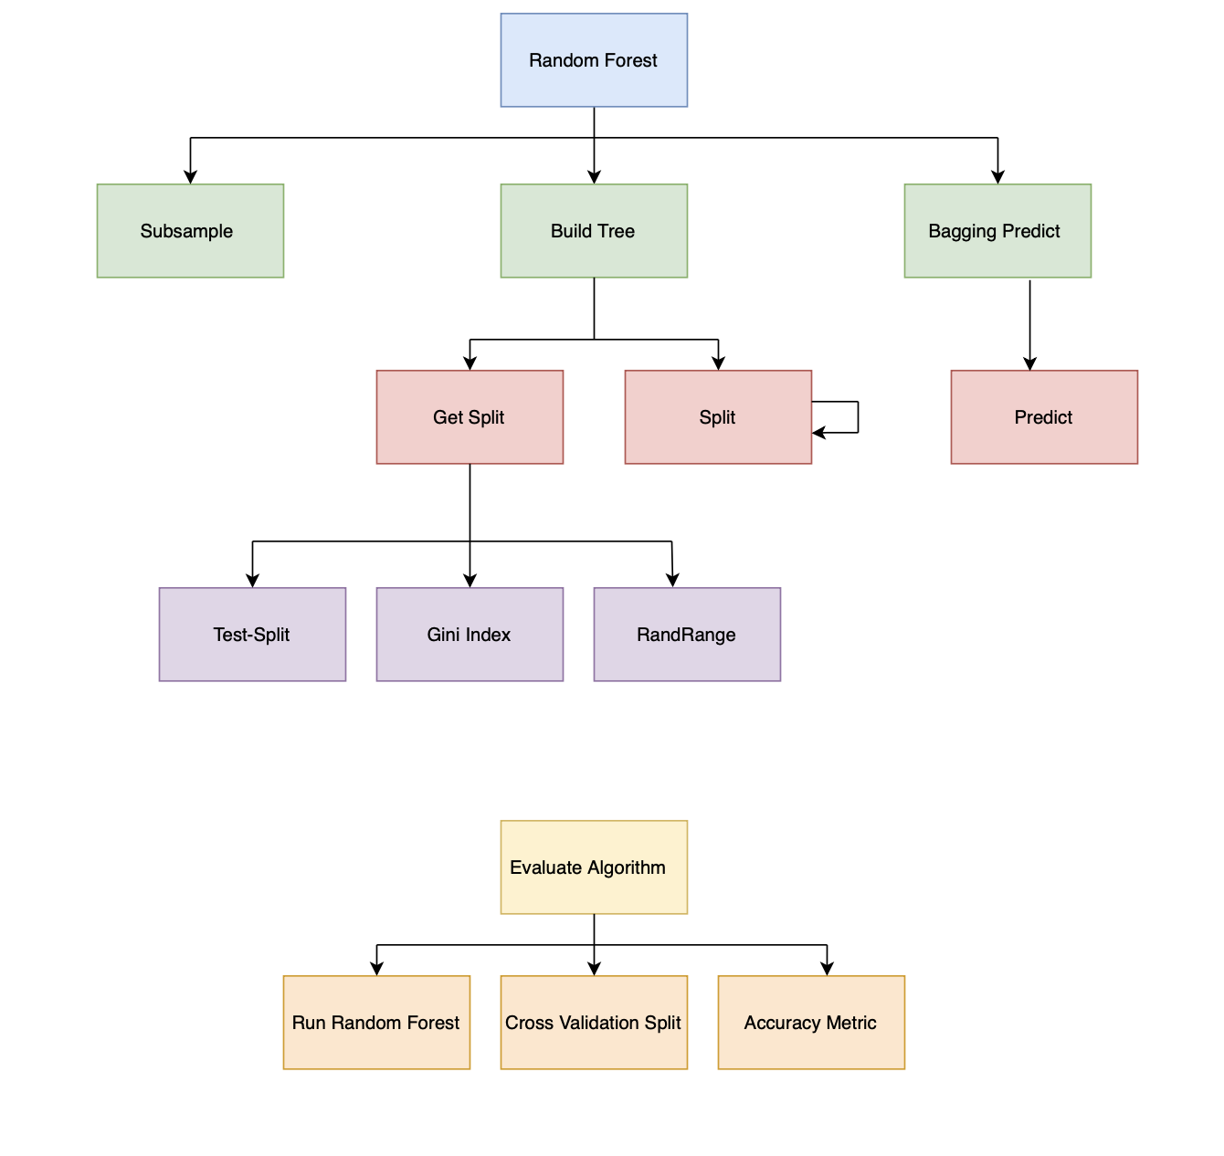
03- Methods
- Naive Bayes
- Random Forest
- SVM
Notes:
Given the non-linear, mostly gaussian distributions of the data across features, we chose to implement a Naive Bayes Classifier, a Random Forest Classifier, and linear and kernel Support Vector Machine to perform binary classification of malignant vs benign samples
(NEXT SLIDE)

Slide 7
04- Results
Method | Naive Bayes | Random Forest (9 Trees) | SVM (linear) | SVM (non-linear)
Model Accuracy on Training set (Cross Validation Score) | 91.3% | 99.558% | 91.9% | 90.1%
Model Accuracy on Test set | 90.35% | 94.8672% | 91.7% | 91.2%
F1 Score | 81.2% | 90.1% | 89% | 87%

Slide 8
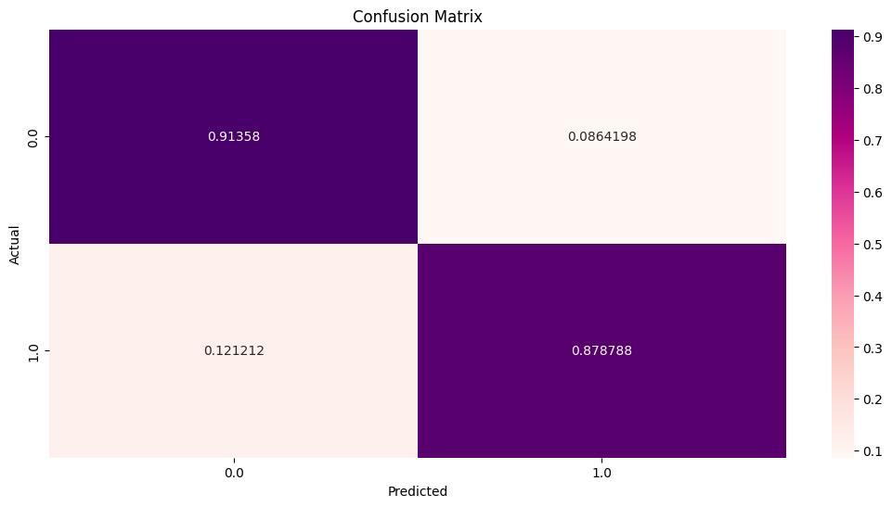
Naive Bayes Confusion Matrix
Method | Naive Bayes
Model Accuracy on Training set (Cross Validation Score) | 91.3%
Model Accuracy on Test set | 90.35%
F1 Score | 81.2%

Slide 9
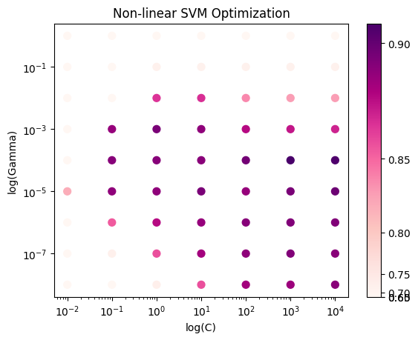
Optimal C: 1000
Optimal Gamma: 0.0001
Notes:
We applied both linear and non linear SVM. We have shown in out results that linear was more accurate.
Non linear SVM used grid search to obtain optimal parameters (C and gamma) - Gamma is a parameter that determines the width of the kernel function, and C is a regularization parameter that controls the trade-off between achieving a good fit to the training data and a simple decision boundary. Accuracy on test set is indicated by color. Highlighted were our optimal parameters.

Slide 10
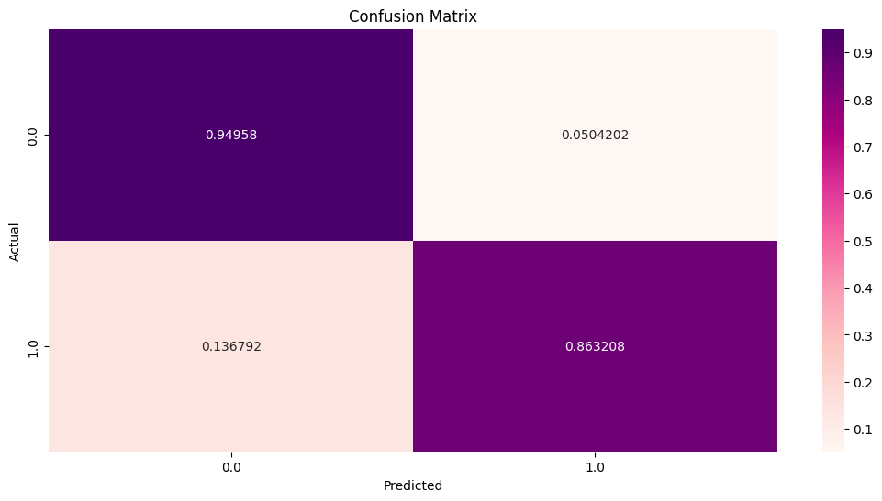
SVM Confusion Matrix
Method | SVM (linear)
Model Accuracy on Training set (Cross Validation Score) | 91.9%
Model Accuracy on Test set | 91.7%
F1 Score | 89%

Slide 11
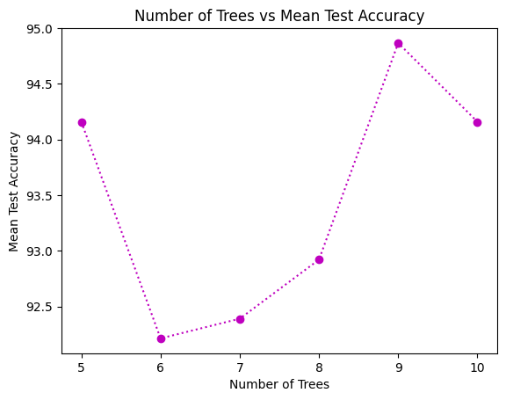
Random Forest
Number of features at each level: 3
Number of trees experimented with: 5-10
Chosen number of trees in our forest: 9
Notes:
For random forest, we choose a subset of features to calculate the information gain from at each level to ensure that we have variance between the trees we generate, and this number is taken as 3 features out of the 10 possible ones, which we choose randomly. This also keeps best feature from being over represented in the trees and having very similar splits.
We tried constructing different random forests of different sizes, specifically ranging from 5-10 trees, and found that using a random forest of 9 trees gives us the best testing accuracy on unobserved data.
Weighted gini index for each group and it treats each group as a category

Slide 12
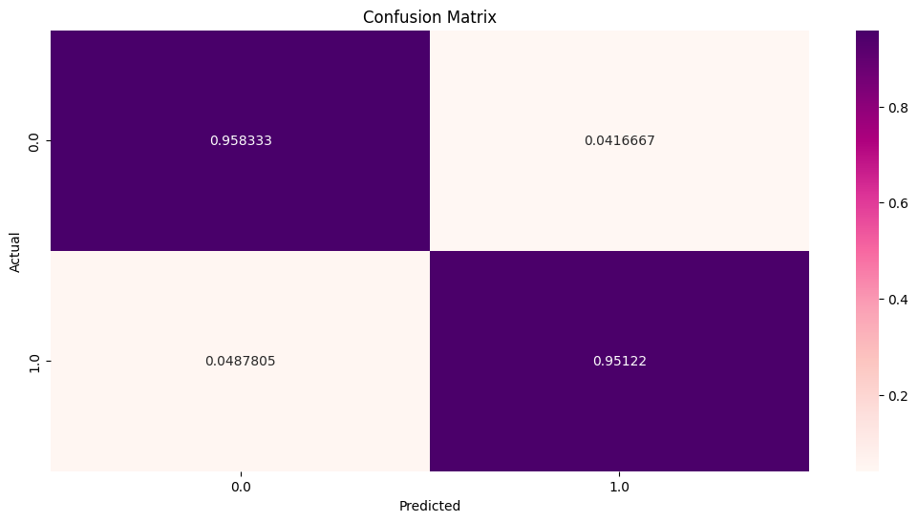
Random Forest Confusion Matrix
Method | Random Forest (9 Trees)
Model Accuracy on Training set (Cross Validation Score) | 99.558%
Model Accuracy on Test set | 94.8672%
F1 Score | 90.1%
Notes:
We get a training accuracy of 99% which indicates that our model could be overfitting due to our limited dataset, and we also obtain a test accuracy of almost 95% for diagnosing on unobserved instances.

Slide 13
05- Conclusions & Future Work
Linear SVM performs better than non-linear SVM
Naive Bayes assume all the features to be independent but it performs surprisingly well.
Random forest performs the best with our dataset
Try to implement a mixture model for the features instead of assuming independence and assess performance
Train our models with more data (569 samples in our dataset) and ensure an equal class distribution
Notes:
From our model results, we can see that Linear SVM performs better than non-linear SVM
And although Naive Bayes assume all the features to be independent, it performed surprisingly well.
We also find that Random forest is the model that performs the best with our dataset
To further improve our results, we can try to implement a mixture model for the features instead of assuming normal distributions and independence and assess performance on a combined model
Also, we can train our models with more data (569 samples in our dataset) and ensure an equal class distribution among our samples

Slide 14
Thank You!
Questions?

Slide 15
References
Centers for Disease Control and Prevention. (2022). Basic Information About Breast Cancer. Retrieved April 27, 2023, from link.
American Cancer Society. (2023). How Common Is Breast Cancer? Retrieved April 27, 2023, from link.
American Cancer Society. (2022). Fine Needle Aspiration Biopsy of the Breast. Retrieved April 27, 2023, from link).
Kaggle UCI Machine Learning Repository. (2016). Breast Cancer Wisconsin (Diagnostic) Data Set. Retrieved April 27, 2023, from link

